Slide 1

Palatte

Slide 2
Template Slide
- Point 1
- Point 2

Slide 3

League of Legends Game Statistic Analysis
Author: Colin Heider
Github Repo: https://github.com/cheider/LeagueofLegends-RankedGame-Analysis

Slide 4
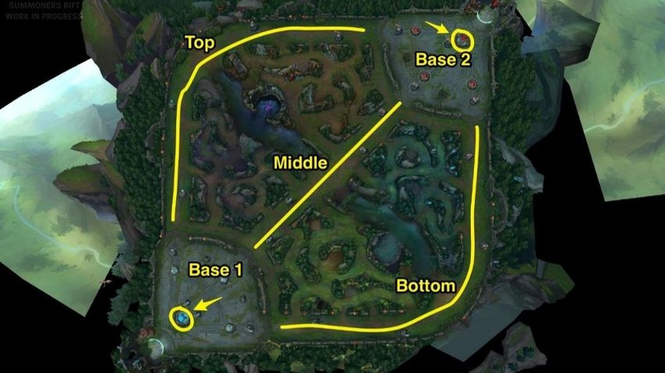
League of Legends
- Competitive team based game
- 5 players versus 5 players
- Battle Arena –> base destruction

Slide 5
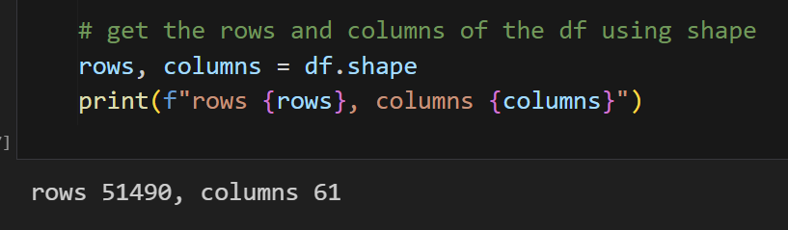
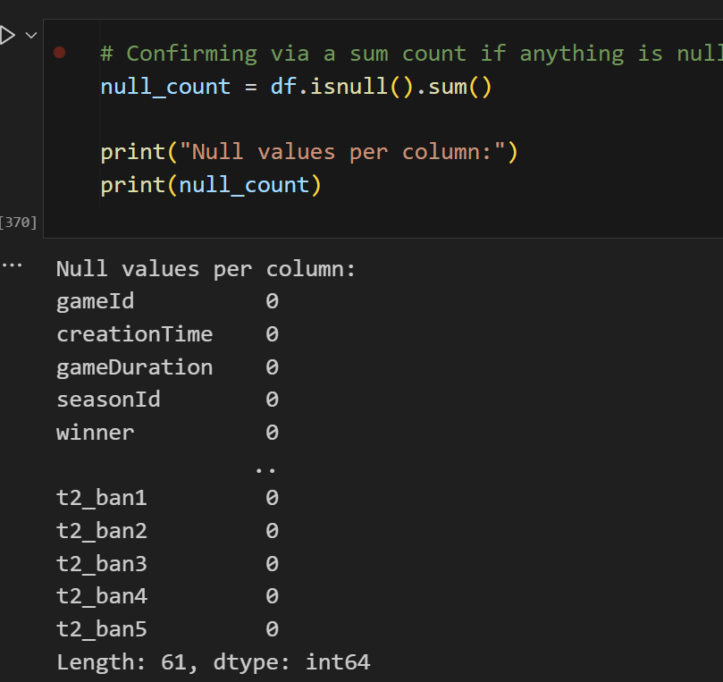
Dataset
- Kaggle datasets
7 years old
- 2 files of champions data
- 1 of spells
- 1 of game stats

Slide 6
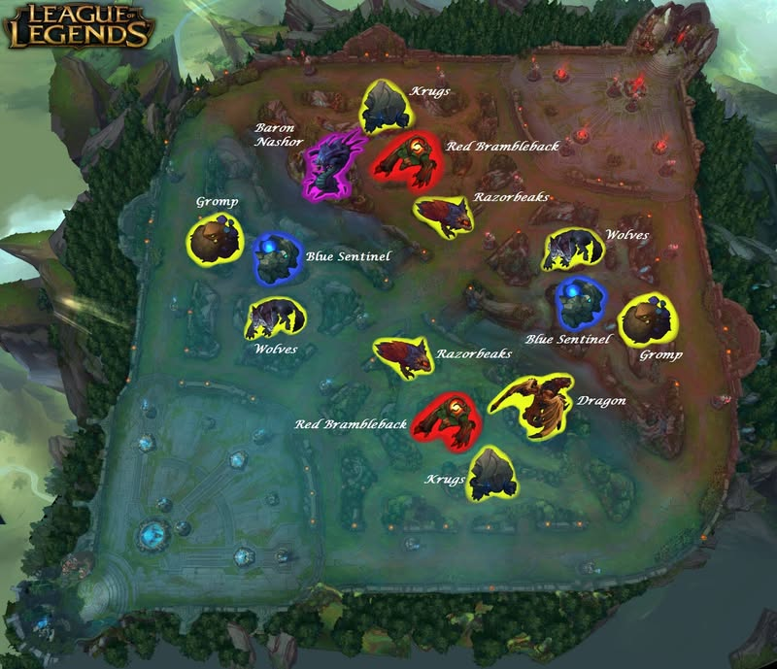
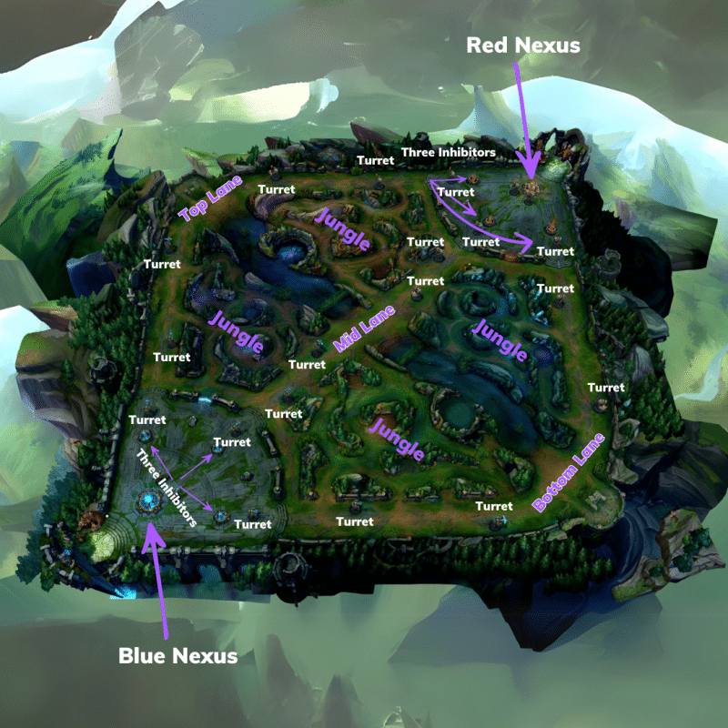
Key Points of Data
- Looking at 3 points of data and influence
- First to these objectives:
Inhibitor, Dragon, Baron

Slide 7

Thesis
First Baron
First Dragon
First Inhibitor
Metrics influence winning chance / correlation

Slide 8
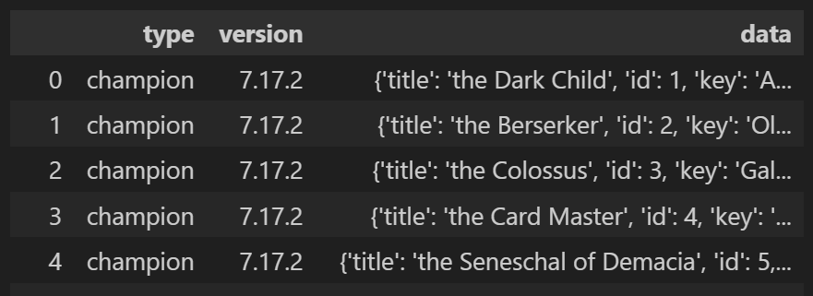
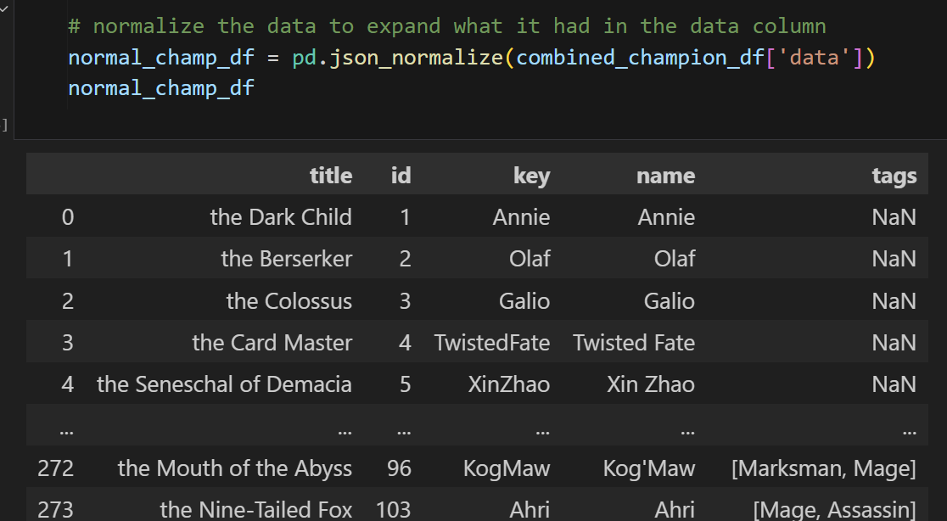
Data Transformation
- 2 json files – merge but 1 was irrelevant
- Normalize json file

Slide 9
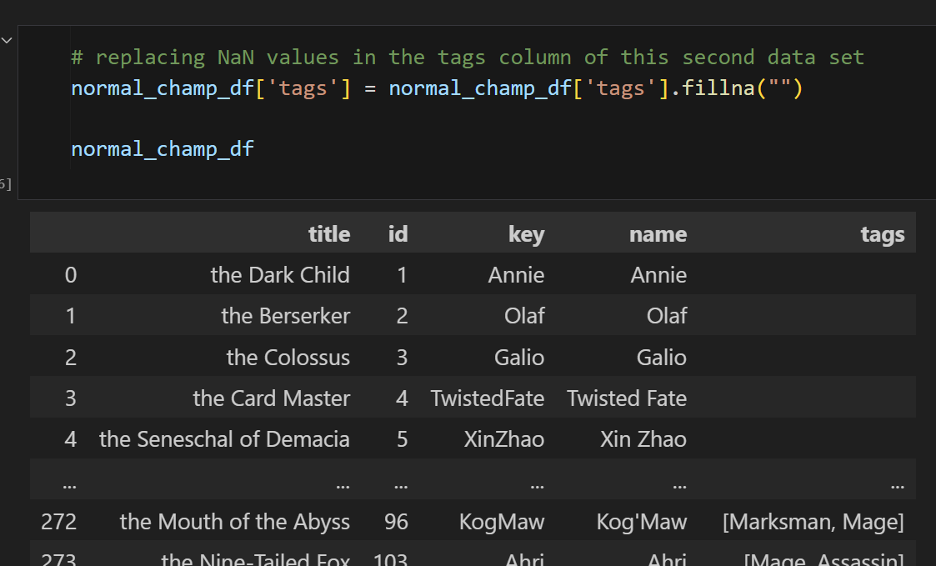
Cont’d
- Removing NaN values

Slide 10
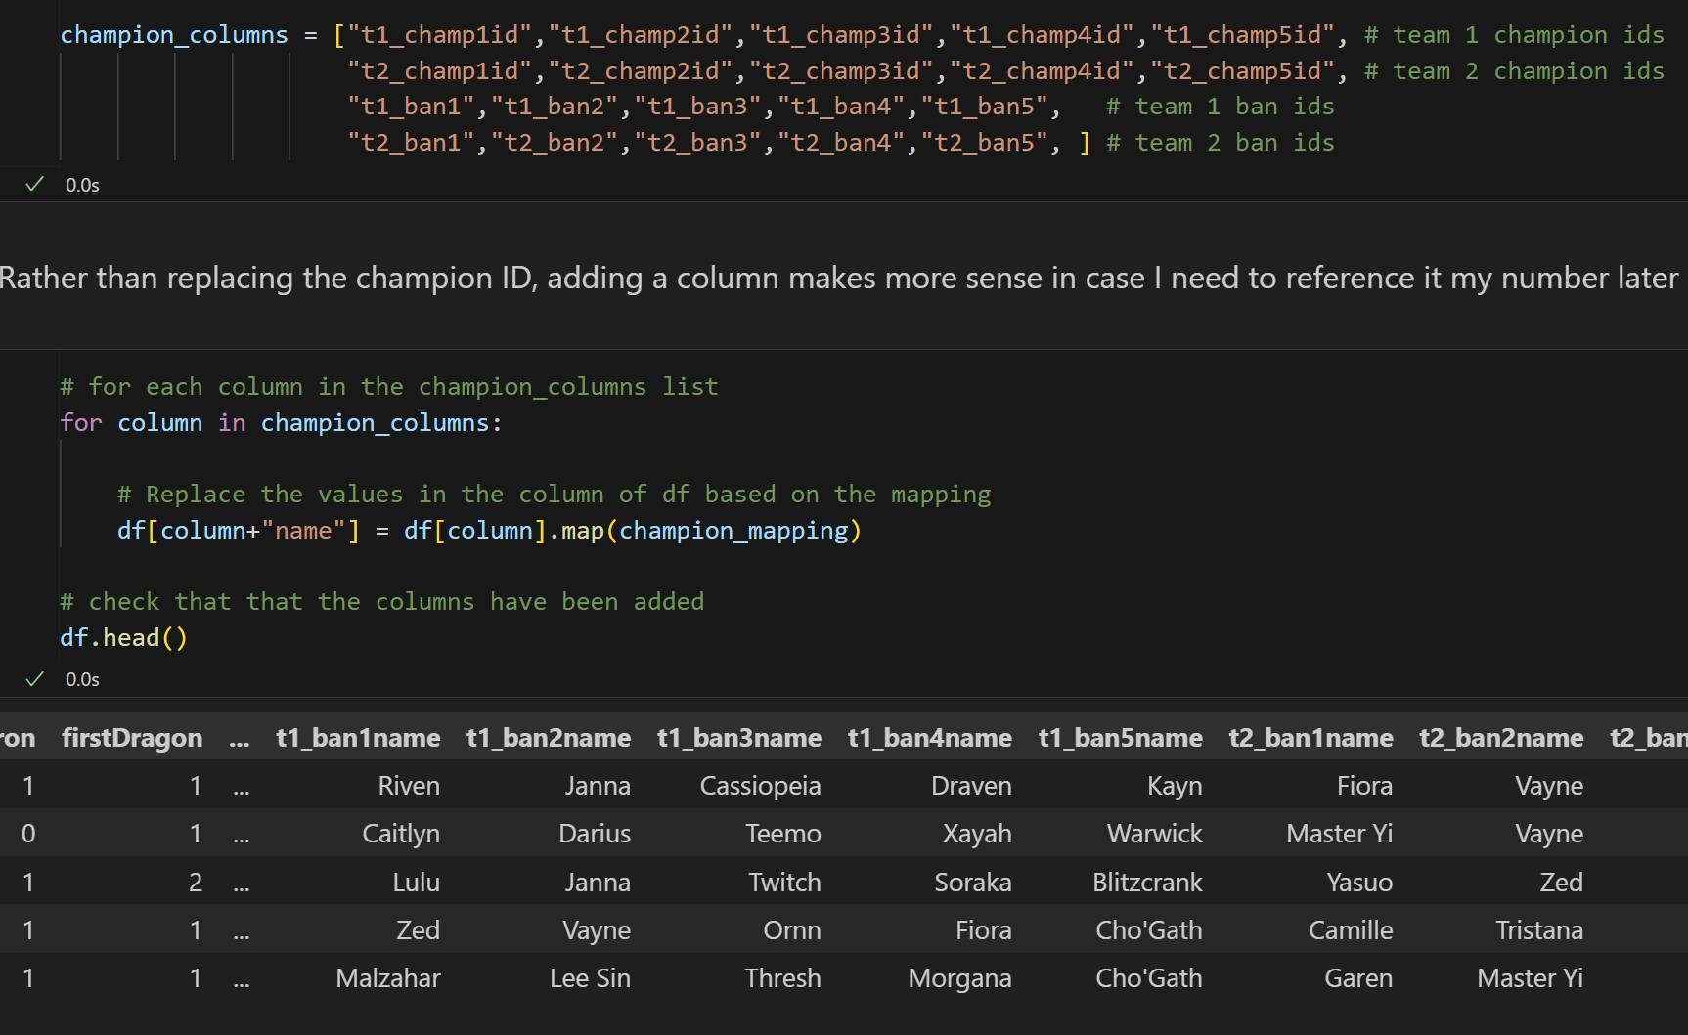
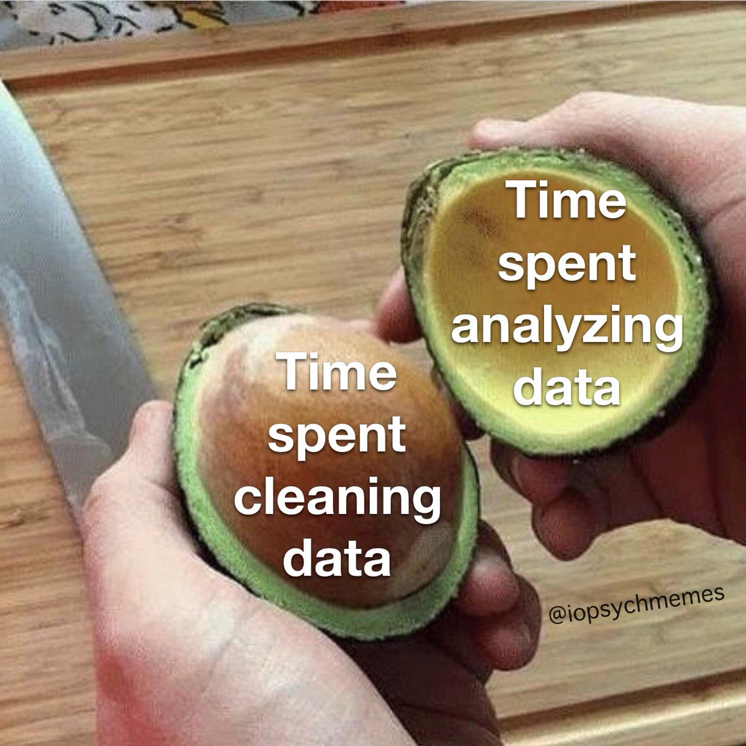
Cont’d
- Mapped Champion Name to ID in data

Slide 11
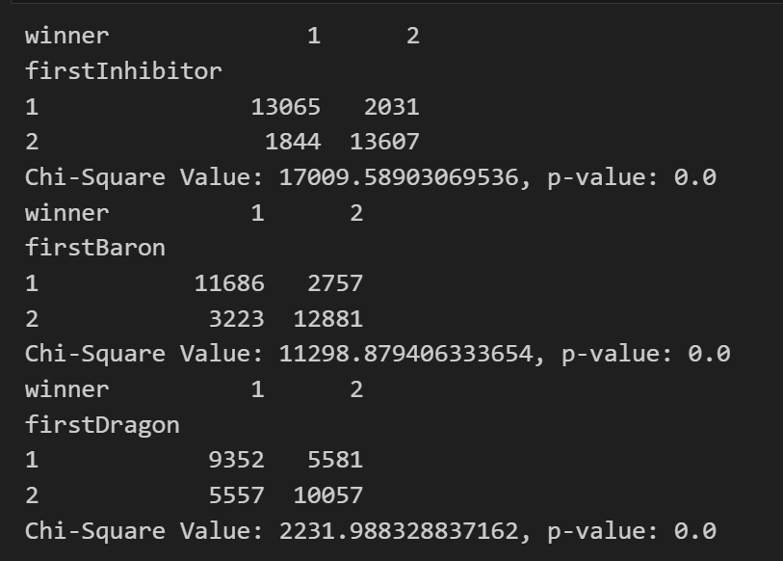
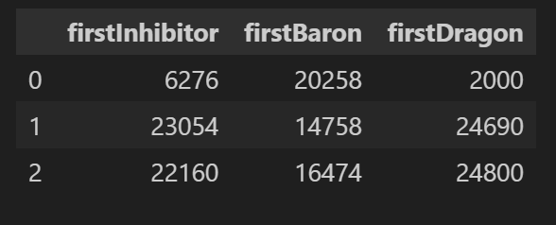

Win / Loss
- Pivot Table
- Point 2
v

Slide 12
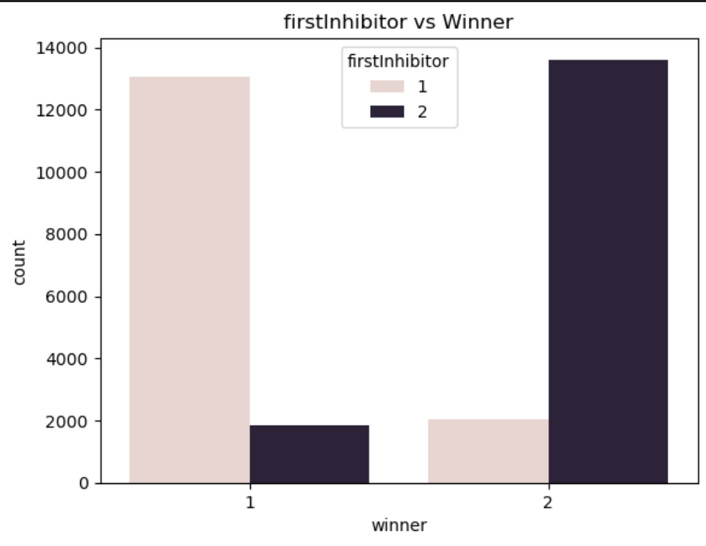
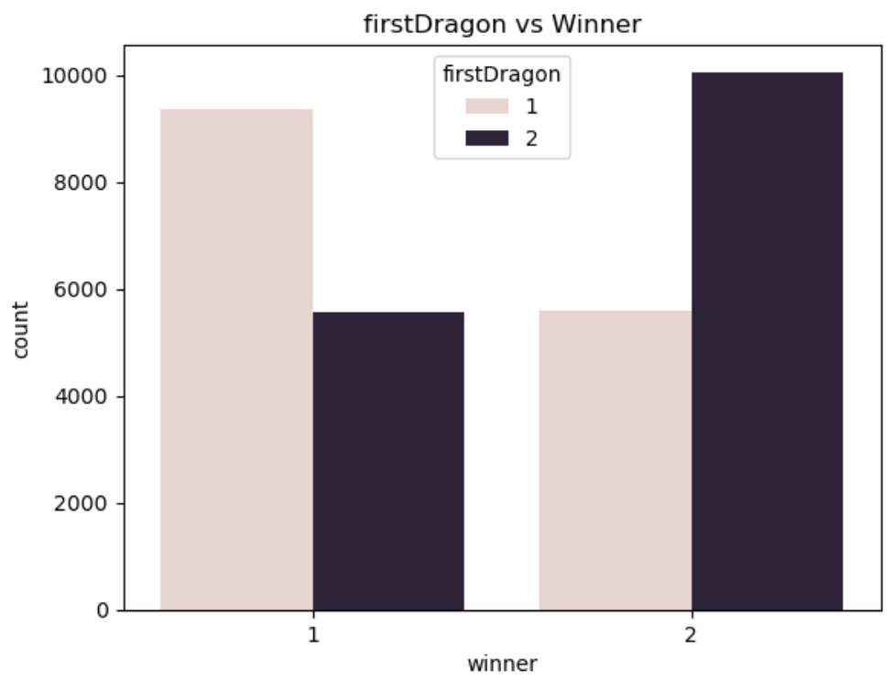
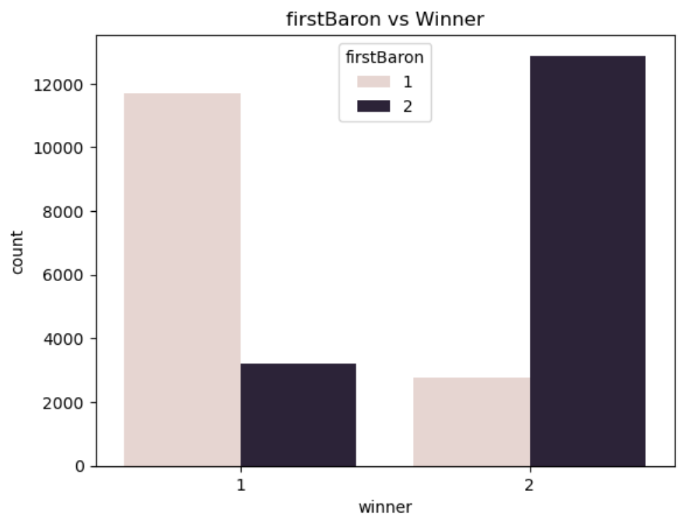
Win / Loss
v

Slide 13
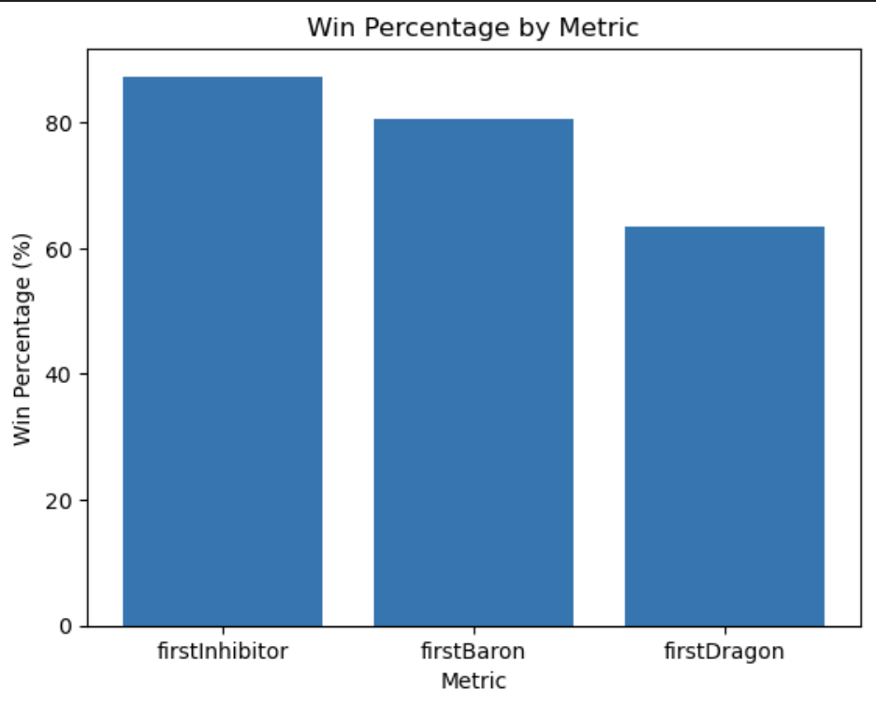
Chance!

Slide 14
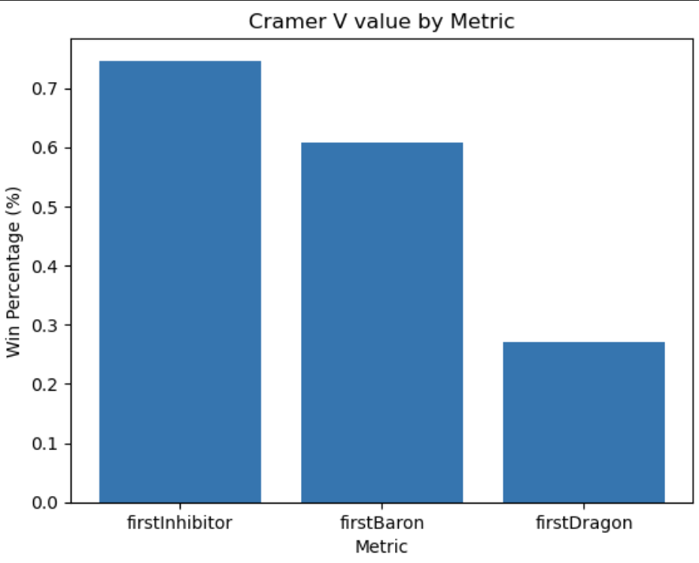
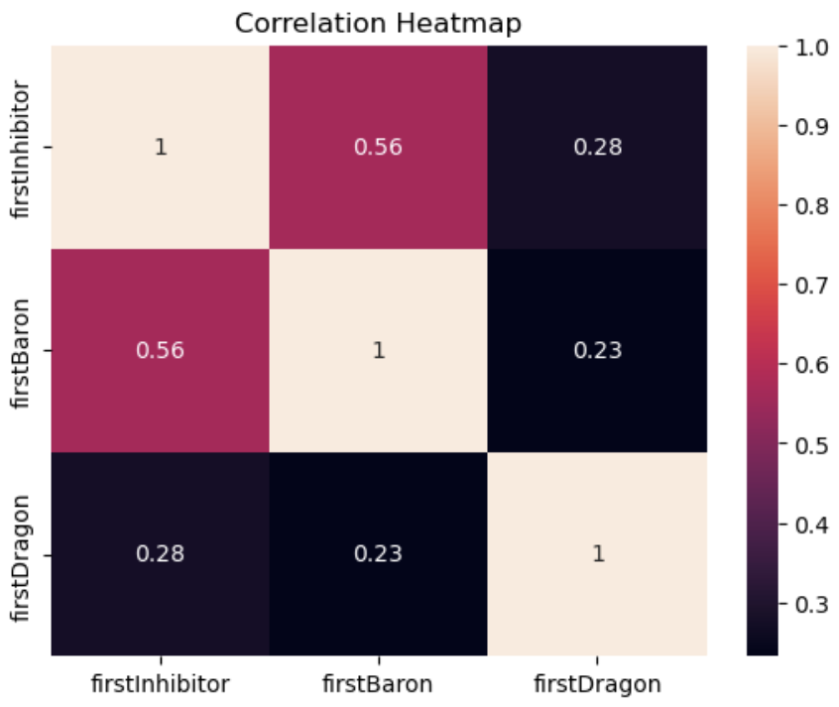
Correlation

Slide 15
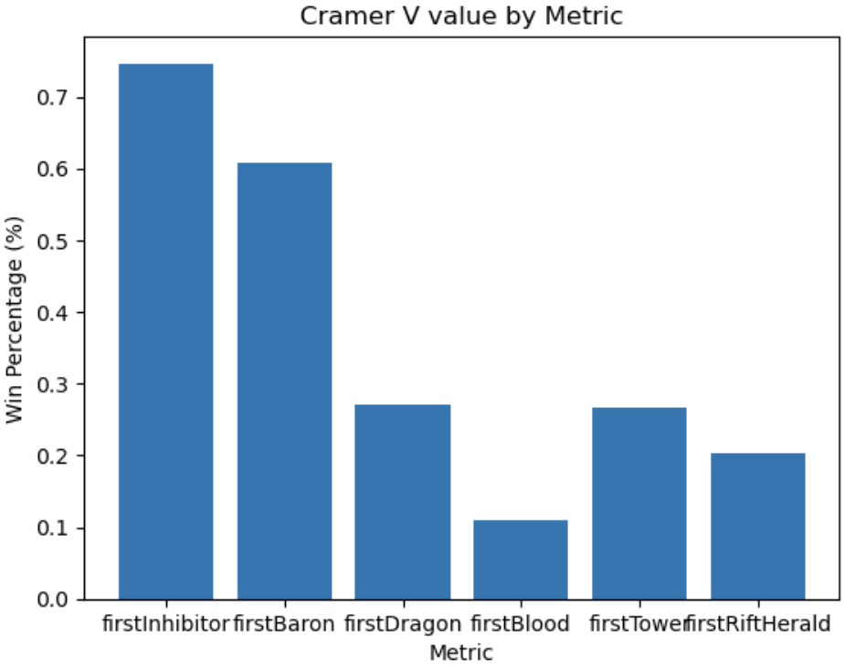
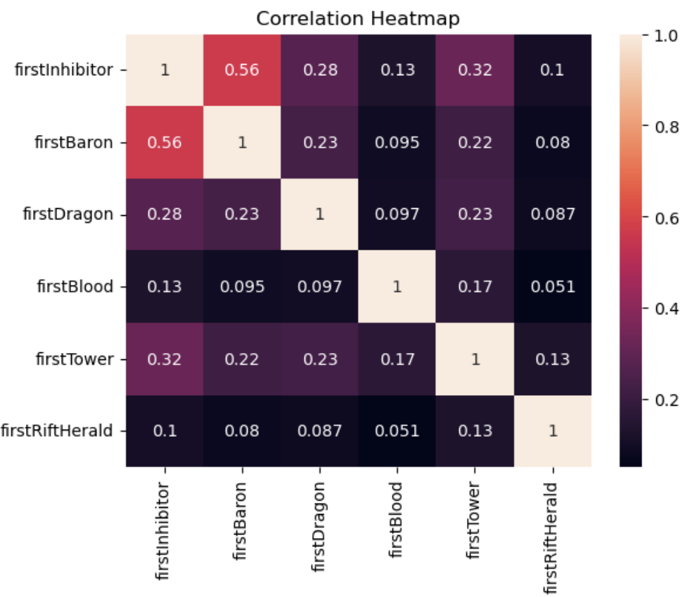
Correlation
Create Frameworks!!

Slide 16

Summary
Hypothesis confirmed!
Get Objectives!!! Inhibitor > Baron >
Dragon

